Slide 1
What is flutter?
It is an open source UI toolkit , developed by Google
An SDK that makes building hybrid and high-performance applications easily.
It can be used to develop bot android and IOS apps.
Dart language is used
Can be use on any platform like:- VS code , android studio and on online compilers.

Slide 2
Why use Flutter ?
Enables testing, animations and designing easily
Provide 60fps animations even on slow devices
Can run on both android and IOS.
Ability to adjust layout according to user

Slide 3
Limitation
Large file size
Limited set of tools libraries
Weak IOS features support
Lack of password manager support

Slide 4
Idea
The main idea behind developing this application is , so many people don’t know how to calculate BMI , so our team decide to make a BMI Calculator.

Slide 5
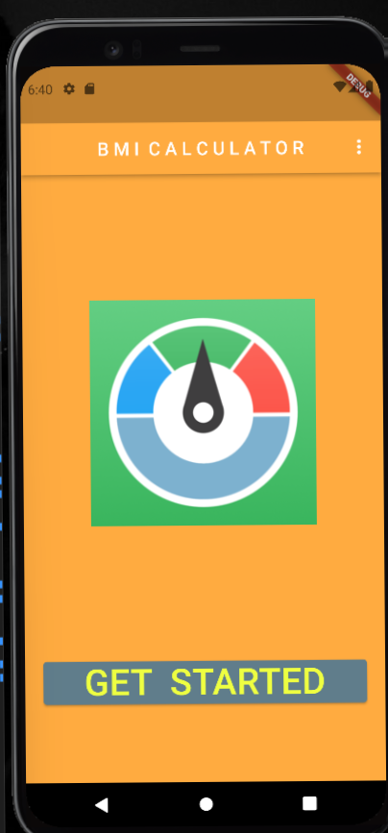

Home page This page contain the get started button. On press this button the app is started.

Slide 6
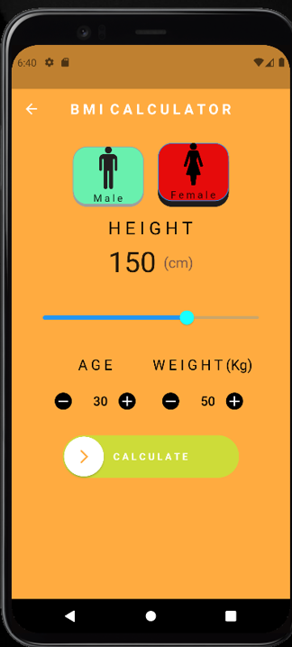
Gender option
On pressing choose the option according to your gender

Slide 7
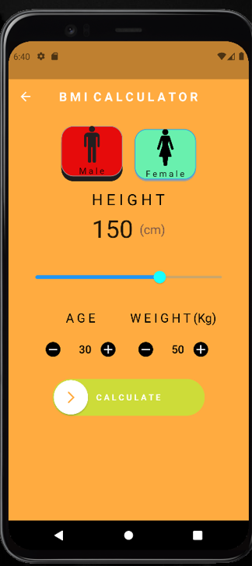
Height Set your height (in cm) by scrolling the meter. Age and weight set your age and weight on pressing (+) and (-) button.

Slide 8
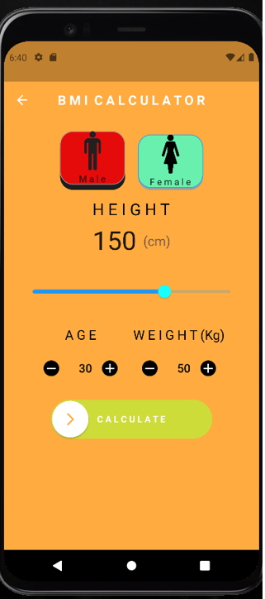
Calculate option calculate your BMI by sliding arrow to right side

Slide 9
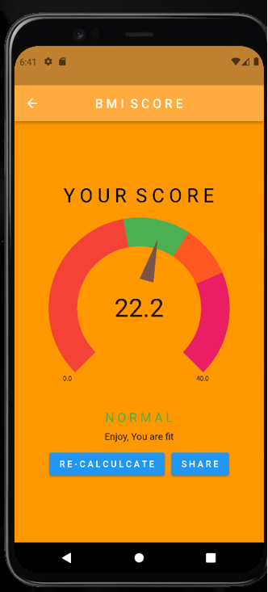
BMI meter It will show BMI . If arrow is on :- red colour means bmi is underweight green colour means bmi is normal orange colour means bmi is overweight pink colour means bmi is obese.

Slide 10
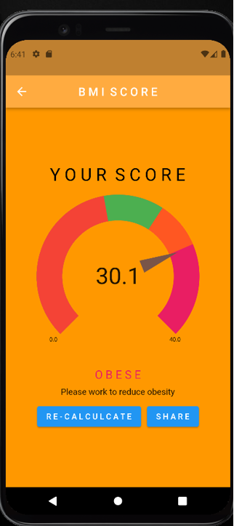
Re calculate on pressing recalcuate button you can calculate bmi again.

Slide 11
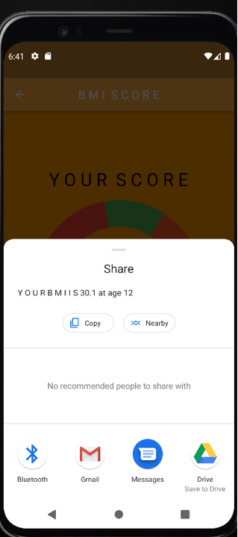
Share medium After selecting share option you will find relevant option where you can share this app to anyone.

Slide 12
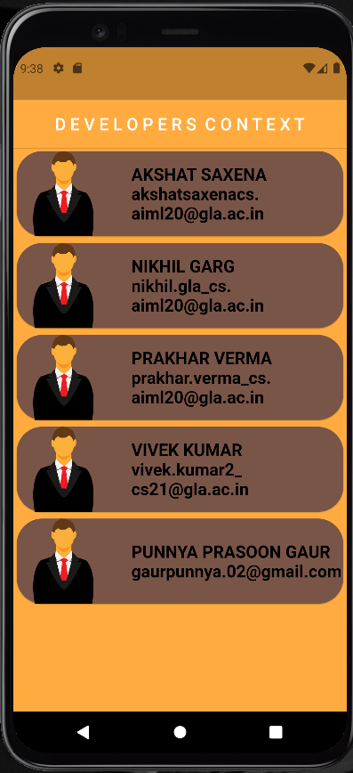
DEV. Context
On this Page you will get the details of the developers of this BMI calculator app

Slide 13
Thank you

